Slide 1
Exploratory Data Analysis & Data Preprocessing
By,
Divesh R. Kubal
Data Scientist, eClerx Services
Center of Excellence – Machine Learning

Slide 2
Table of Contents
The need for Data Science
What is Data Science?
The lifecycle of Data Science
Why Exploratory Data Analysis?
Summary Statistics
Visualization
Implementation of Use Case

Slide 3
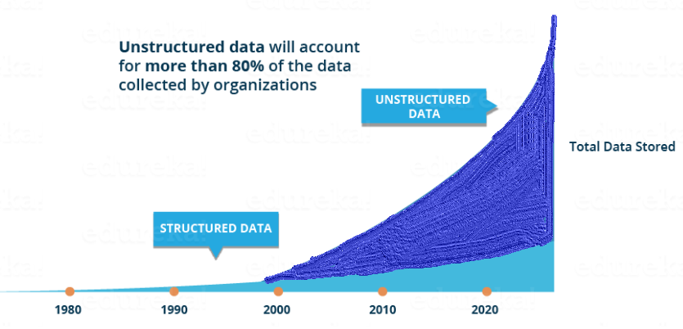
Why We Need Data Science

Slide 4
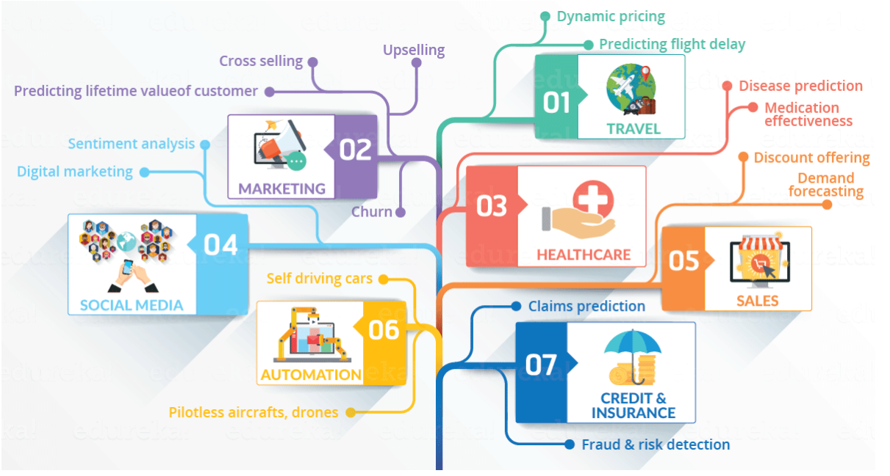
Domains

Slide 5
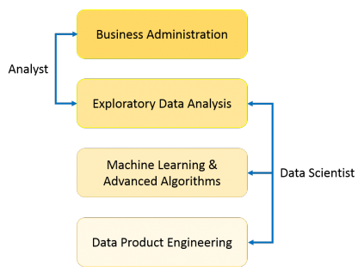
What is Data Science?
Data Science is a blend of various tools, algorithms, and machine learning principles with the goal to discover hidden patterns from the raw data

Slide 6
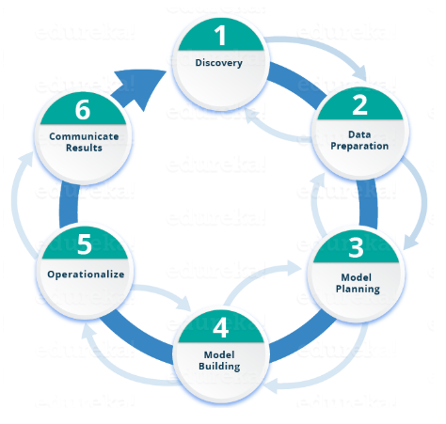
Lifecycle of Data Science

Slide 7
Why Data Exploration?
A preliminary exploration of the data to better understand its characteristics.
Key motivations of data exploration include
Helping to select the right tool for preprocessing, data analysis and data mining
Making use of humans’ abilities to recognize patterns
People can recognize patterns not captured by data analysis tools
Related to the area of Exploratory Data Analysis (EDA)
Created by statistician John Tukey
Seminal book is Exploratory Data Analysis by Tukey
A nice online introduction can be found in Chapter 1 of the NIST Engineering Statistics Handbook

Slide 8
Exploratory Data Analysis
In statistics, exploratory data analysis (EDA) is an approach to analyzing data sets to summarize their main characteristics, often with visual methods.
A statistical model can be used or not, but primarily EDA is for seeing what the data can tell us beyond the formal modeling or hypothesis testing task.

Slide 9
Exploratory Data Analysis
Exploratory Data Analysis is one of the important steps in the data analysis process.
Focus is on making sense of the data in hand – things
Formulating the correct questions to ask to your dataset, how to manipulate the data sources to get the required answers, and others.
Done by taking an elaborate look at trends, patterns, and outliers using a visual method.

Slide 10
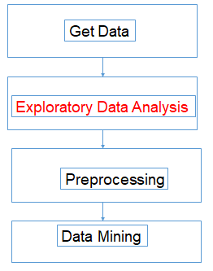
Exploratory Data Analysis

Slide 11
Tools and Techniques used in EDA
Univariate visualisation
Bivariate visualisations
Multivariate visualisations
Classification and dimension reduction techniques
K-means clustering
Predictive models

Slide 12
How does EDA help your business and where does it fit in?
Helps to understand if the results they’ve produced are correctly interpreted and if they apply to the required business contexts.
Benefits stakeholders by confirming if the questions they’re asking are right or not.
Gives any organization the necessary confidence in their data
Ignoring this crucial step can lead you to build your Business Intelligence System on a very shaky foundation.

Slide 13
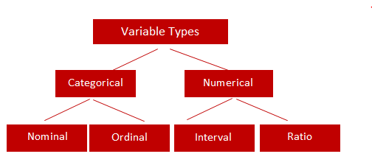
TYPES OF VARIABLES

Slide 14
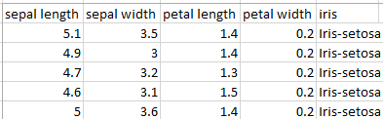
Bifurcating Predictor(s) and Target
Predictors/Features/Independent Attributes.
Target/Response/Dependent Attribute.
Classes

Slide 15
Iris Sample Data Set
Many of the exploratory data techniques are illustrated with the Iris Plant data set.
Can be obtained from the UCI Machine Learning Repository http://www.ics.uci.edu/~mlearn/MLRepository.html
From the statistician Douglas Fisher
Three flower types (classes):
Setosa
Virginica
Versicolour
Four (non-class) attributes
Sepal width and length
Petal width and length

Slide 16
Lets get into Implementation

